Slide 1
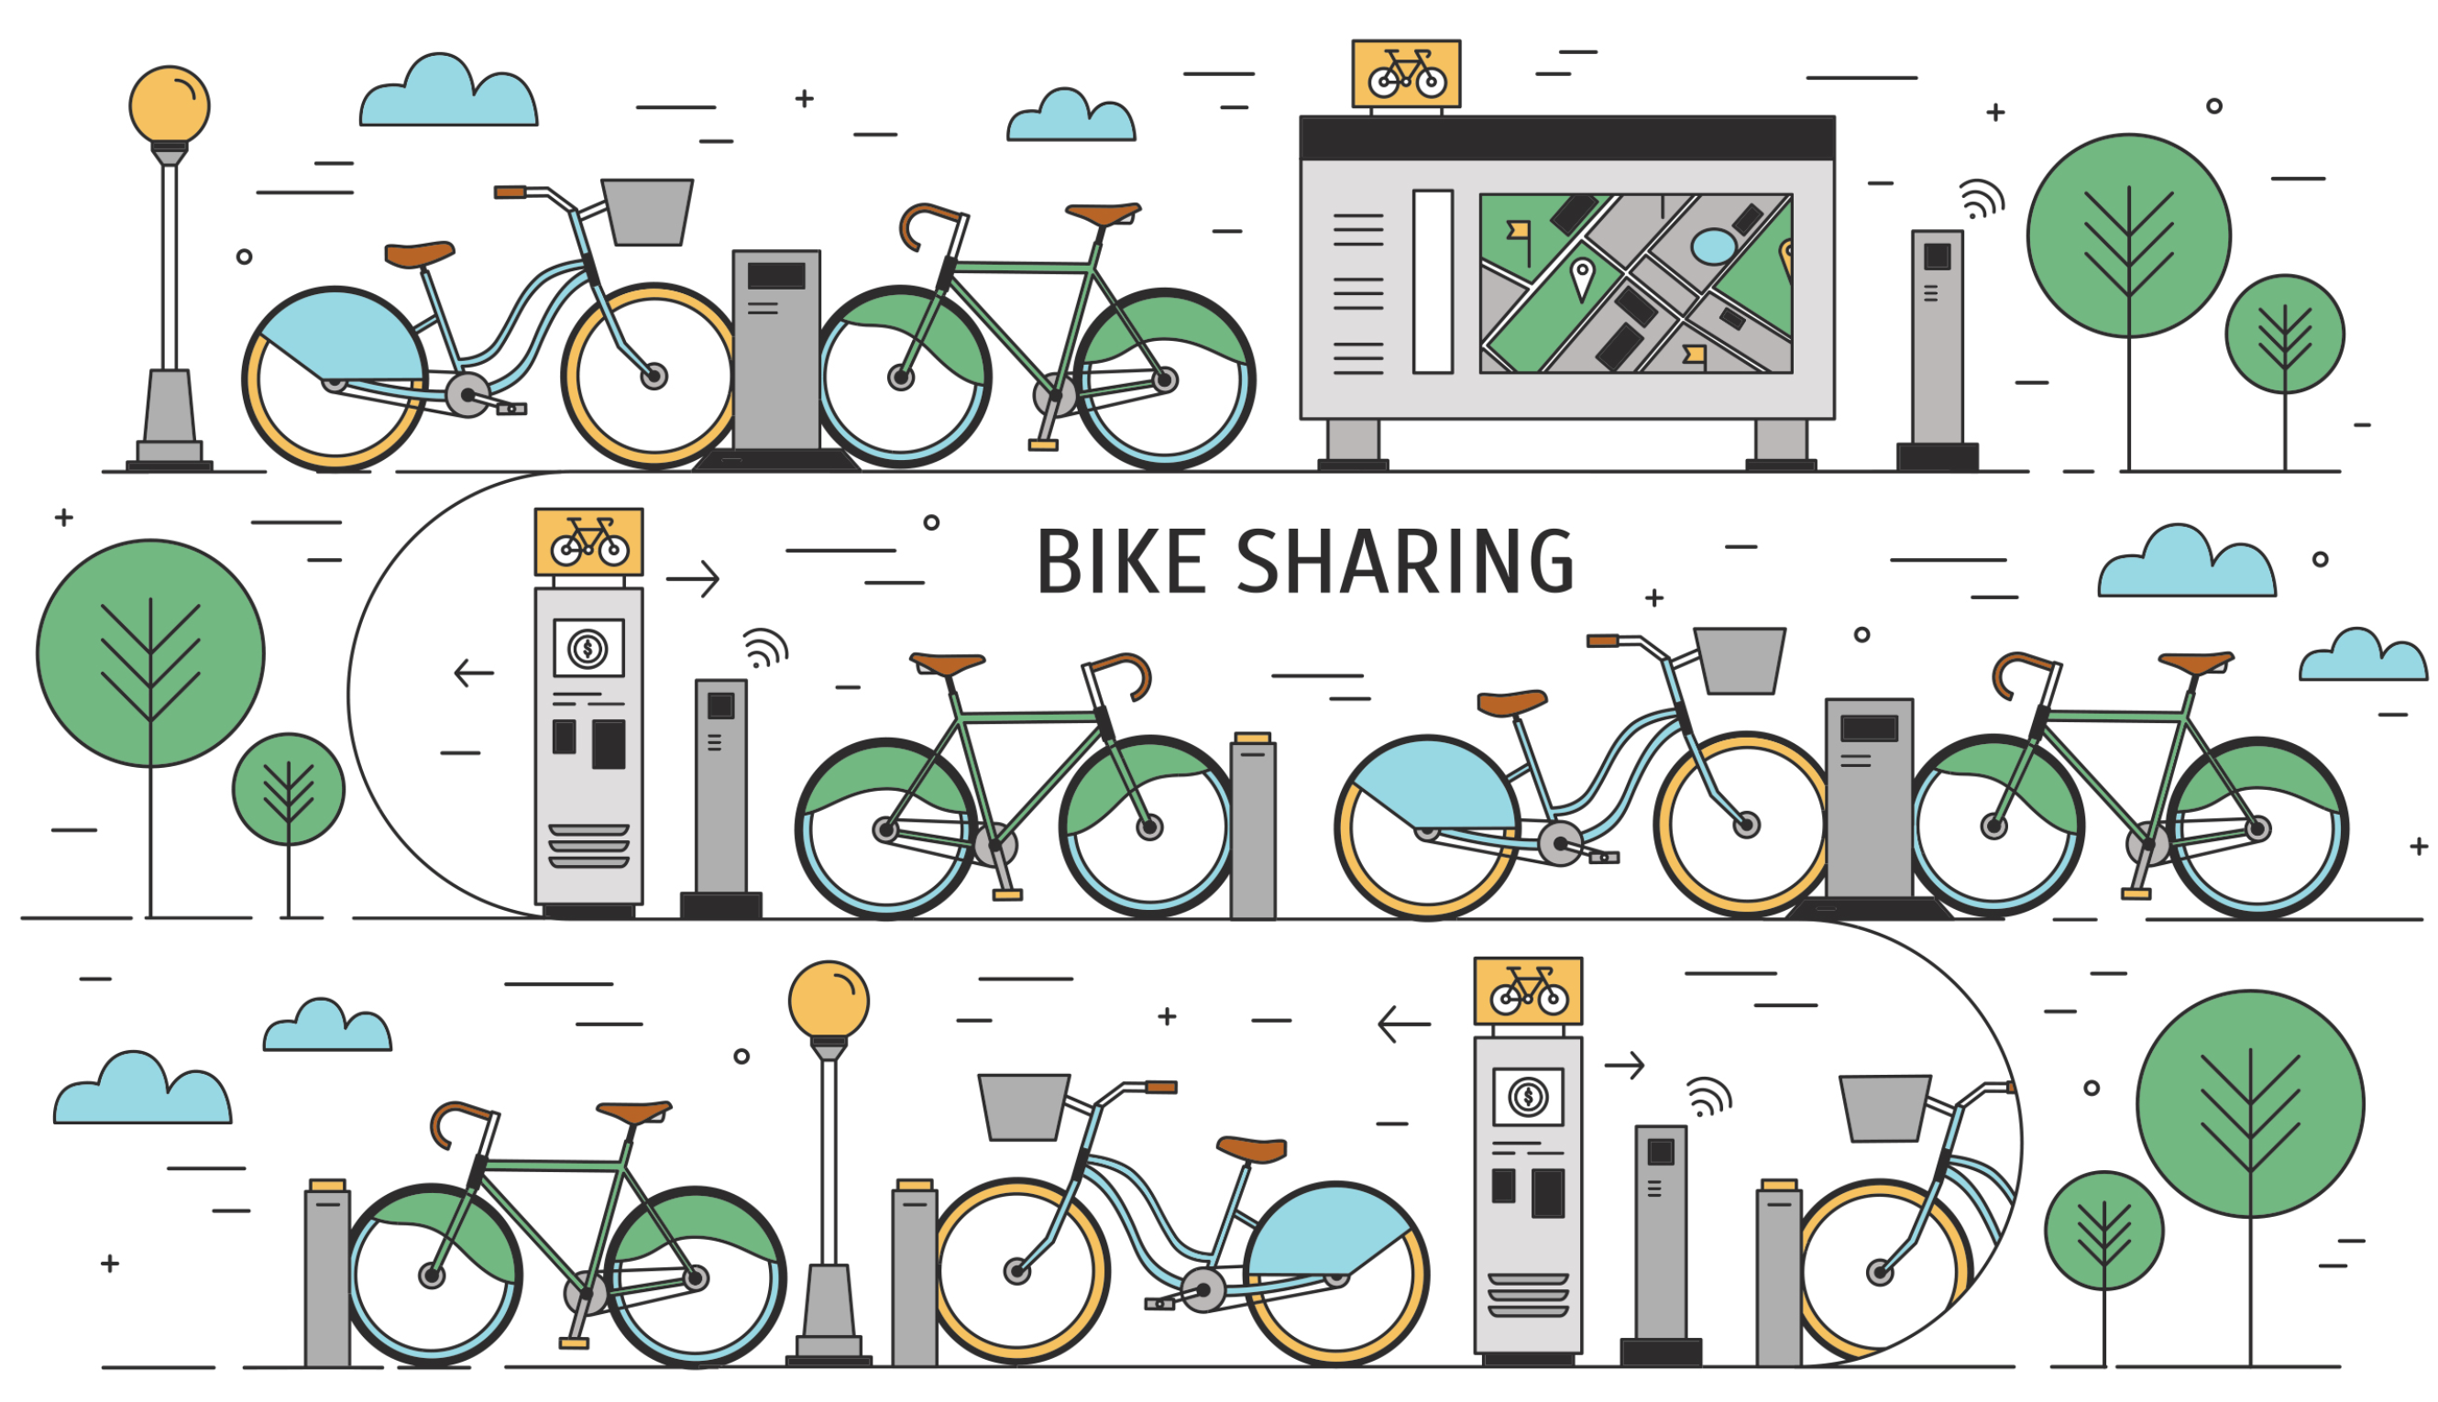
Modelling Bike Sharing with SimPy
By Xiaoyan Li and Lanpei Li

Slide 2
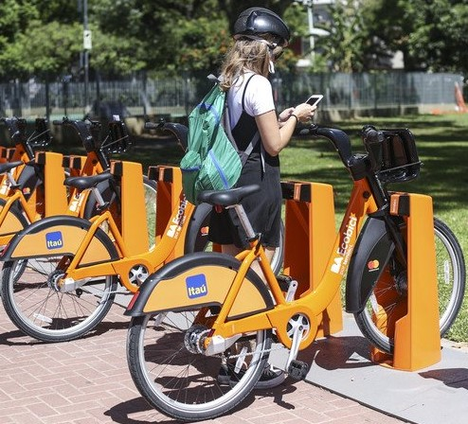
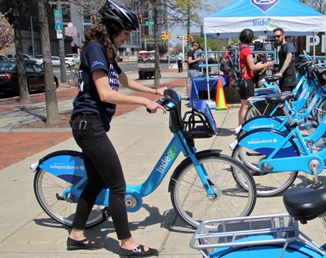

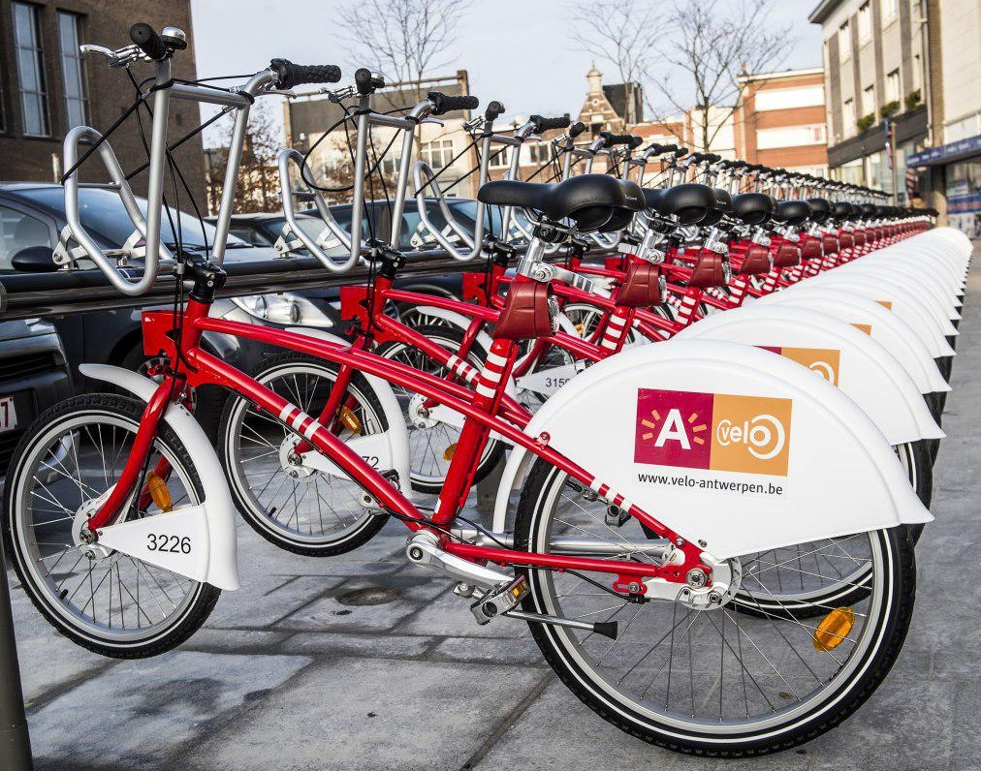

Passenger
Travelling
Put a bike
Get a bike
Put a bike
Waiting
Leave
Abandon

Slide 3
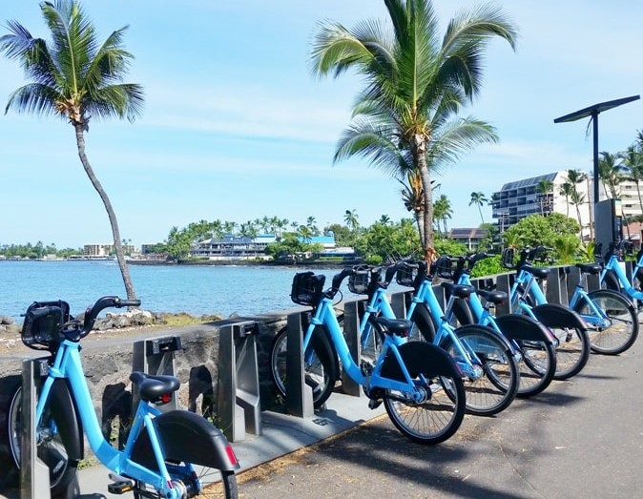
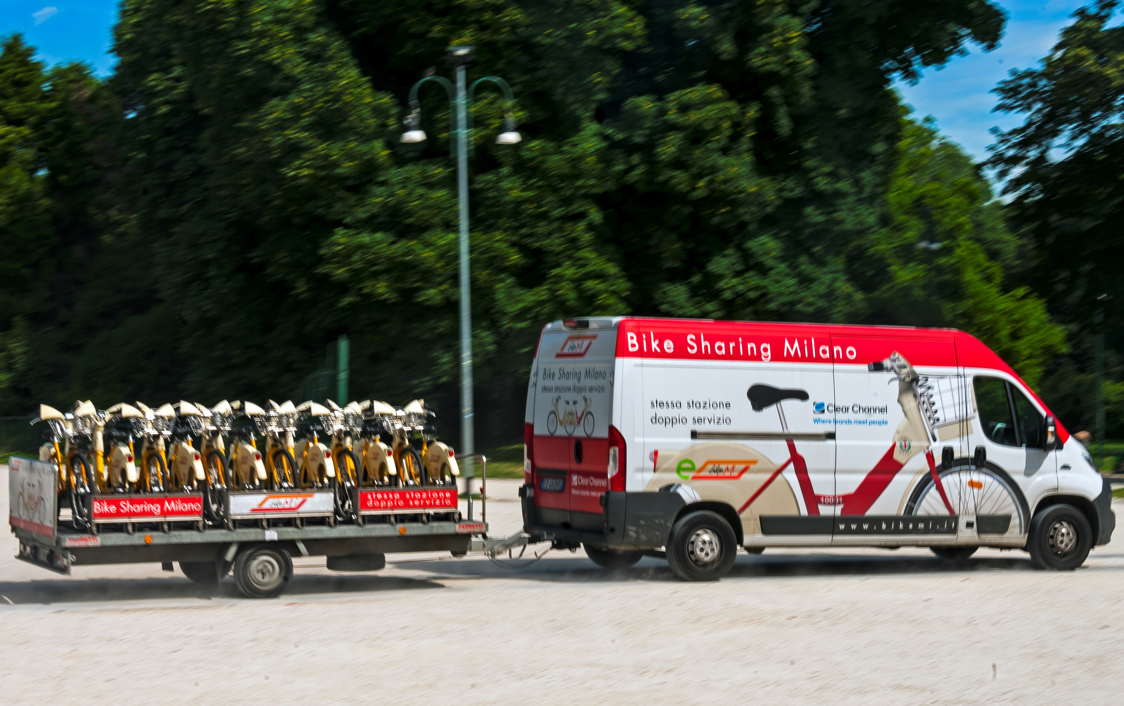
Station
Call a vehicle
Put/remove bikes
Call a vehicle
Put/remove bikes
……
……

Slide 4
Simpy
Process
Process
Event
...
…
…
Event
…
…
…
Event/Resource
Event
Event
Environment
Processes : modelling behaviour of active components.
Events : Process, Timeout,…
Shared resources :
Resources – Resources that can be used by a limited number of processes at a time .
Containers – Resources that model the production and consumption of a homogeneous, undifferentiated bulk.
Stores – Resources that allow the production and consumption of Python objects.

Slide 5
Implementation
Station
__init__(…)
get_bike(…)
put_bike(…)
reset_station(…)
monitor_proc(…)
self.bike = simpy.Container(env, init=num_bikes, capacity=capacity)
self.mon_proc = env.process(self.monitor_proc(env))
self.depot_station = depot_station
self.capacity = capacity
self.init_ratio = init_ratio
self.reset_ratio = reset_ratio
yield self.env.timeout(random.randint(1, 3))
yield self.env.timeout(random.randint(5, 10))
amount = math.ceil(self.bike.capacity//2 - self.bike.level)
if amount > 0:
yield self.bike.put(amount)
elif amount < 0:
yield self.bike.get(abs(amount))
while True:
if self.bike.level <= self.capacity*self.reset_ratio \
or self.bike.level >= self.capacity*(1-self.reset_ratio):
# get an available vehicle from the depot station
……
if repo_vehicle.level <= repo_vehicle.capacity - \
self.depot_station.reset_threshold:
yield repo_vehicle.get(self, 1)
yield self.env.timeout(1) # check the status every 1 minutes
Init with init_rato × capacity(the number of docks in the station).
The monitor process : If #bikes/capacity is not in the range[reset_ratio, 1-reset_ratio], repositioning vehicle will be called to refill/remove bikes, resetting the station to a state that one half is empty, and one half is filled with bikes.

Slide 6
Implementation
Depot station
__init__(…)
monitor_proc(…)
self.vehicle_store = [Vehicle(id, MyContainer(env, init=num_stations//2, \
capacity=num_stations//2), True) \
for id in range(num_vehicles)]
self.reset_threshold = reset_threshold
self.reset_delay = reset_delay
for c_id in range(num_vehicles):
self.mon_proc = env.process(self.monitor_proc(env, c_id))
Init with capacity(num_vehicles). A vehicle is a container with capacity 10, meaning one vehicle can only serve at most 10 stations during one trip.
The monitor process : when a vehicle receives calls from some number of stations, then it start departing to serve them. Note the number could be different in peak commuting hours.
while True:
# get the repo vehicle with c_id
……
# calculate departure_time_interval
……
waiting_event = self.env.timeout(departure_time_interval)
yield vehicle_signal_start | waiting_event
if len(repo_vehicle.stations) > 0:
# get station list stas from repo_vehicle.stations
……
for station in stas:
yield self.env.process(station.reset_station())
yield repo_vehicle.put(station, 1)
yield self.env.timeout(1) # check the status every 1 minutes

Slide 7
Implementation
Passenger
__init__(…)
Get a bike
Travelling
Put a bike
self.start_station = start_station
self.end_station = end_station
request = self.start_station.bike.get(1)
waiting_event = self.env.timeout(random.randrange(10,20))
res = yield request | waiting_event
if request in res:
yield self.env.process(self.start_station.get_bike(self.passenger_id))
else:
request.cancel() # The request is cancelled; passenger leaves
yield self.env.timeout(random.randint(10, 3*60))
Passengers are generated with different arrival rates in five periods(early-hours, morning, noon, evening, midnight), amounting to around 3720 per day. The time interval between two consecutive passenger follows the exponential distribution.
request = self.end_station.bike.put(1)
waiting_event = self.env.timeout(random.randrange(20,30))
res = yield request | waiting_event
if request in res:
yield self.env.process(self.end_station.put_bike(self.passenger_id))
else:
request.cancel() # The request is cancelled; passenger abandon the bike
Passengers have a limited patience to get/put a bike :
(10, 20) minutes to get a bike, otherwise they would leave.
(20, 30) minutes to put a bike, otherwise they may not park the bike in the dock properly.

Slide 8
Implementation
day_splitting = {
"early-hours" : (night_duration/2, night_rate),
"morning" : (morning_duration, peak_rate),
"noon" : (noon_duration, noon_rate),
"evening" : (evening_duration, peak_rate),
"midnight" : (night_duration/2, night_rate)
}
Main
day_splitting
run_system(…)
main(…)
depot_station = Depot_Station(env, num_vehicles, num_stations, reset_threshold, reset_delay)
stations = [Station(env, id, depot_station, math.ceil(capacity*init_ratio), \
capacity, init_ratio, reset_ratio) for id in range(num_stations)]
passenger_id = 0
for _, (duration, rate) in day_splitting.items():
period = 0
while (period <= duration):
start_station, end_station = random.choice(stations), random.choice(stations)
pax = Passenger(env, passenger_id, start_station, end_station)
env.process(pax.behave())
# Using the inverse CDF algorithm to generate passengers from the exponential distribution
p = random.random()
interval_arrival_time = -math.log(1.0 - p)/rate
period += interval_arrival_time
passenger_id += 1
yield env.timeout(interval_arrival_time)
Run the system.
# Run the simulation
env = simpy.Environment()
env.run(env.process(run_system(env, num_vehicles, num_stations, capacity, init_ratio, reset_ratio, reset_threshold, reset_delay)))

Slide 9
Case study
Base case (no Patience strategy, no Refilling strategy).
N.stations | 20
Capacity | 25
Init-ratio | 0.7
Average-waiting-time | 33 mins 19 secs
Max-waiting-time | 374 mins 56 secs
N_passengers_ arrived | 3743
N_passengers_served | 3428
Base case + Patience strategy.
Average-waiting-time | 4 mins 24 secs
Max-waiting-time | 29 mins 0 secs
N_impatiences_get | 705
N_impatiences_put | 9
N_passengers_ arrived | 3713
N_passengers_served | 2904
N.stations | 20
Capacity | 25
Init-ratio | 0.7

Slide 10
with Refilling strategy
N.vehicles | 20 | 10 | 5 | 5 | 5 | 5 | 5
Capacity | 25 | 25 | 25 | 25 | 5 | 5 | 25
Init-ratio | 0.7 | 0.6 | 0.7 | 0.8 | 0.6 | 0.7 | 0.6
Reset-ratio | 0.5 | 0.5 | 0.1 | 0.3 | 0.1 | 0.5 | 0.3
Reset-threshold | 6 | 4 | 8 | 6 | 4 | 8 | 6
Reset-delay | 10 | 10 | 30 | 20 | 10 | 30 | 30
Average-waiting-time | 1 mins 60 secs | 1 mins 60 secs | 2 mins 26 secs | 2 mins 3 secs | 6 mins 23 secs | 6 mins 53 secs | 2 mins 7 secs
Max-waiting-time | 13 mins 38 secs | 10 mins 60 secs | 31 mins 22 secs | 26 mins 19 secs | 30 mins 6 secs | 30 mins 29 secs | 28 mins 40 secs
Refilling-times | 244 | 288 | 48 | 101 | 174 | 78 | 75
N_impatiences_get | 0 | 0 | 75 | 4 | 966 | 1126 | 6
N_impatiences_put | 0 | 0 | 21 | 0 | 142 | 176 | 6
num_stations (20) : the number of stations.
num_vehicles ([5,10,20]) : the number of vehicles in a depot station.
capacity ([5,15,25]) : the capacity of each station.
init_ratio ([0.6,0.7,0.8]) : #bikes / capacity in each station initially.
reset ratio ([0.1,0.3,0.5]) : #bikes/capacity to call for repositioning vehicles.
reset_threshold ([4,6,8]) : the number of stations received (10 - reset_threshold) for a vehicle to depart.
reset_delay ([10,20,30]) : the time interval to send a vehicle.

Slide 11
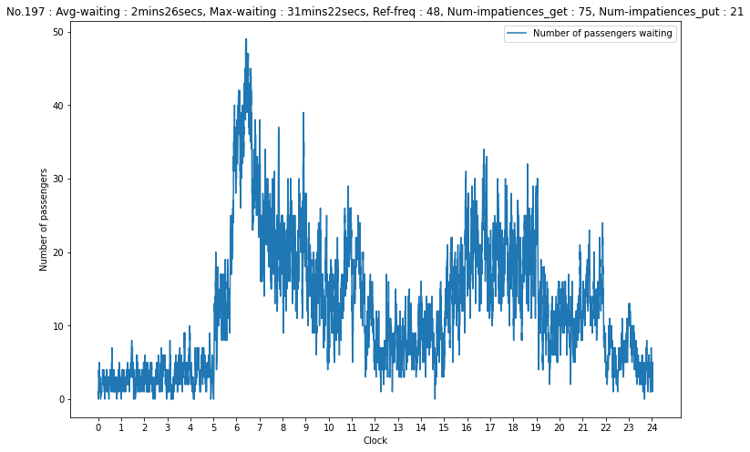
Plotting
N.stations | 20
N.vehicles | 5
Capacity | 25
Init-ratio | 0.7
Reset-ratio | 0.1
Reset-threshold | 8
Reset-delay | 30

Slide 12
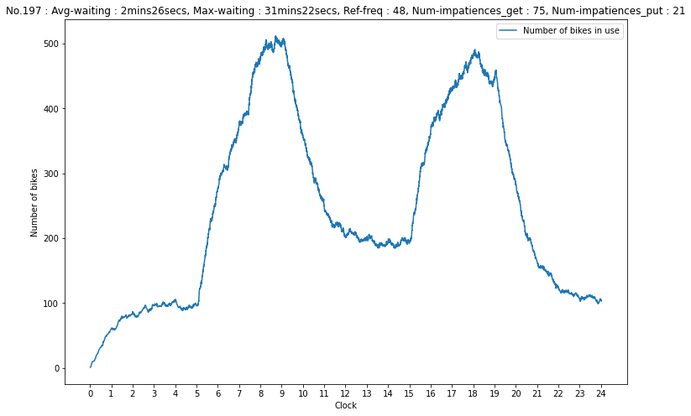
Plotting
N.stations | 20
N.vehicles | 5
Capacity | 25
Init-ratio | 0.7
Reset-ratio | 0.1
Reset-threshold | 8
Reset-delay | 30

Slide 13
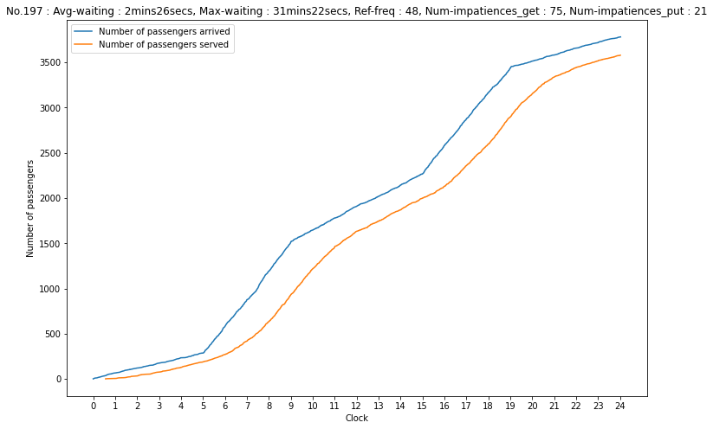
Plotting
N.stations | 20
N.vehicles | 5
Capacity | 25
Init-ratio | 0.7
Reset-ratio | 0.1
Reset-threshold | 8
Reset-delay | 30

Slide 14
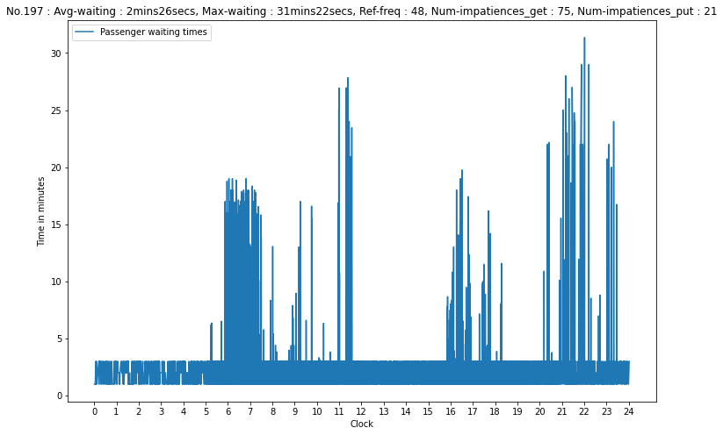
Plotting
N.stations | 20
N.vehicles | 5
Capacity | 25
Init-ratio | 0.7
Reset-ratio | 0.1
Reset-threshold | 8
Reset-delay | 30

Slide 15
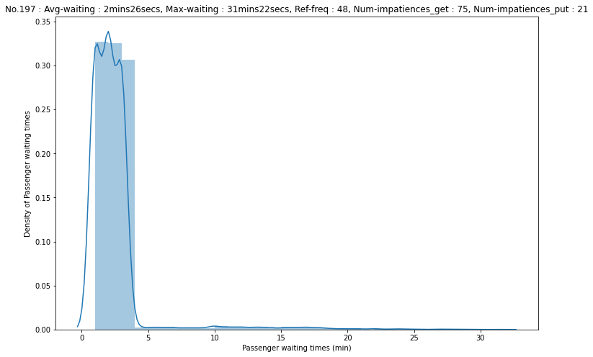
Plotting
N.stations | 20
N.vehicles | 5
Capacity | 25
Init-ratio | 0.7
Reset-ratio | 0.1
Reset-threshold | 8
Reset-delay | 30

Slide 16
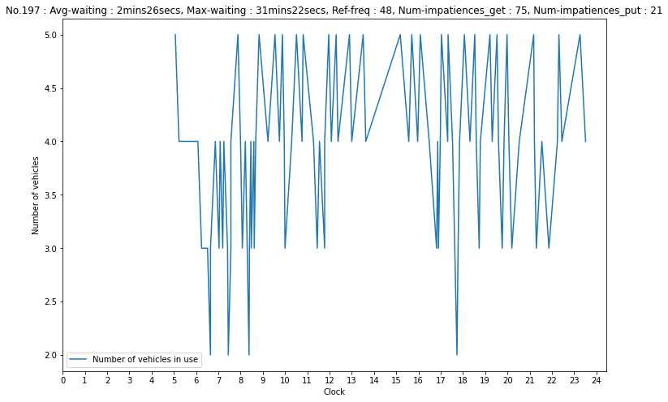
Plotting
N.stations | 20
N.vehicles | 5
Capacity | 25
Init-ratio | 0.7
Reset-ratio | 0.1
Reset-threshold | 8
Reset-delay | 30

Slide 17
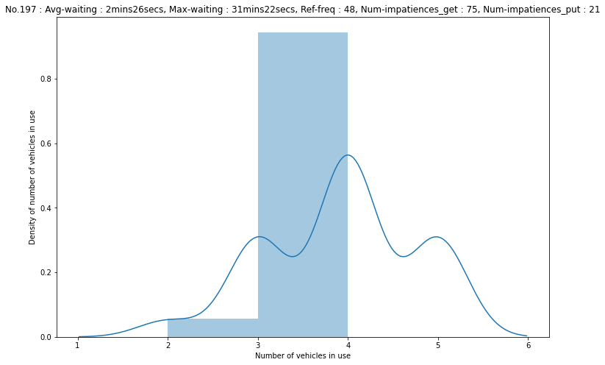
Plotting
N.stations | 20
N.vehicles | 5
Capacity | 25
Init-ratio | 0.7
Reset-ratio | 0.1
Reset-threshold | 8
Reset-delay | 30

Slide 18
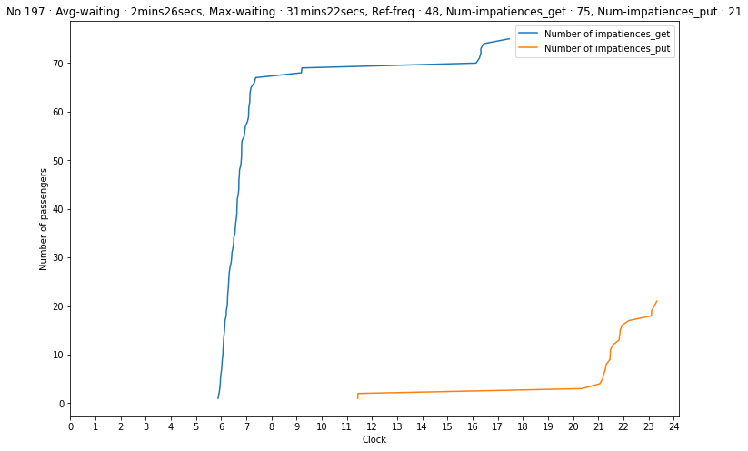
Plotting
N.stations | 20
N.vehicles | 5
Capacity | 25
Init-ratio | 0.7
Reset-ratio | 0.1
Reset-threshold | 8
Reset-delay | 30

Slide 19
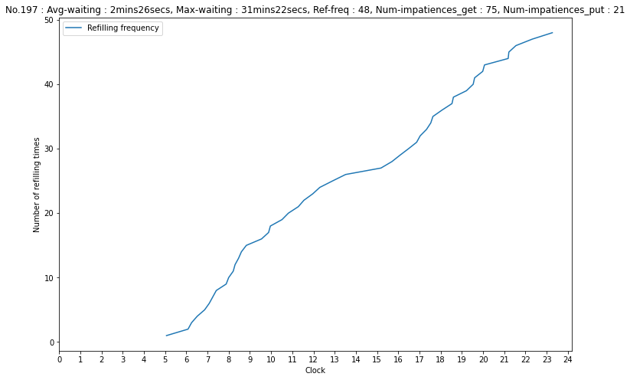
Plotting
N.stations | 20
N.vehicles | 5
Capacity | 25
Init-ratio | 0.7
Reset-ratio | 0.1
Reset-threshold | 8
Reset-delay | 30

Slide 20
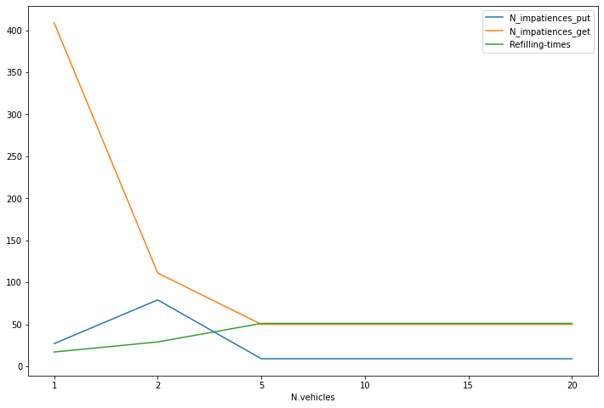
Grid search
N.stations | 20
N.vehicles | 1,2,5,10,15,20
Capacity | 25
Init-ratio | 0.7
Reset-ratio | 0.1
Reset-threshold | 6
Reset-delay | 30

Slide 21
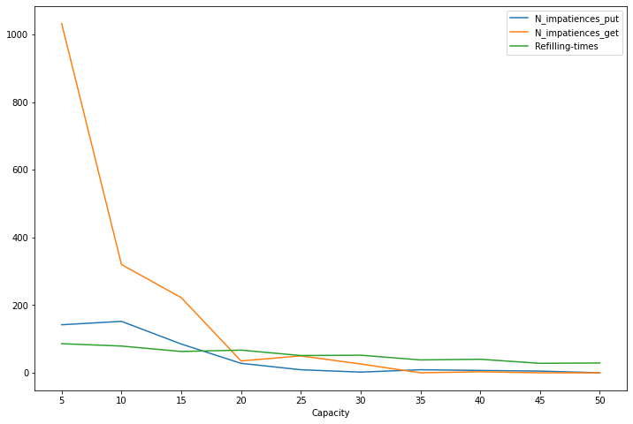
Grid search
N.stations | 20
N.vehicles | 5
Capacity | 5,10,15,20,25,30,35,40,45,50
Init-ratio | 0.7
Reset-ratio | 0.1
Reset-threshold | 6
Reset-delay | 30

Slide 22
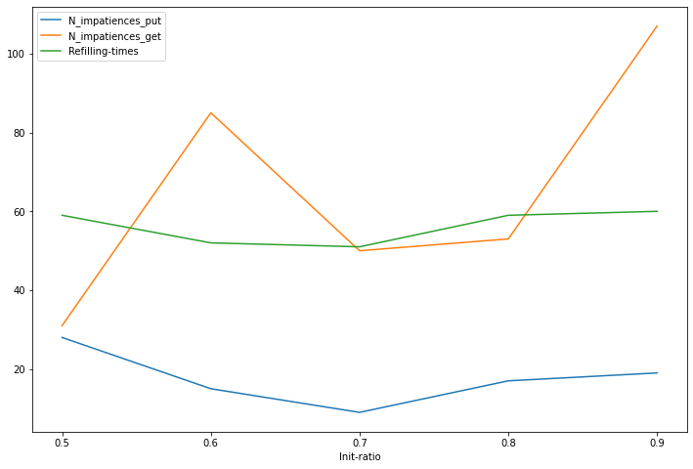
Grid search
N.stations | 20
N.vehicles | 5
Capacity | 25
Init-ratio | 0.5,0.6,0.7,0.8,0.9
Reset-ratio | 0.1
Reset-threshold | 6
Reset-delay | 30

Slide 23
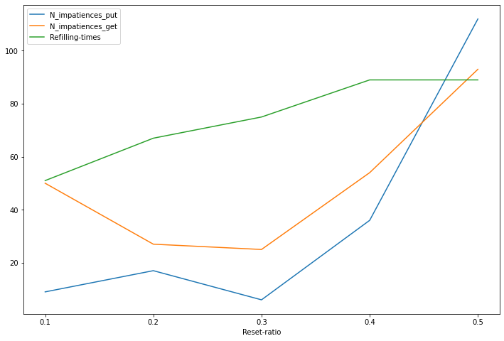
Grid search
N.stations | 20
N.vehicles | 5
Capacity | 25
Init-ratio | 0.7
Reset-ratio | 0.1,0.2,0.3,0.4,0.5
Reset-threshold | 6
Reset-delay | 30

Slide 24
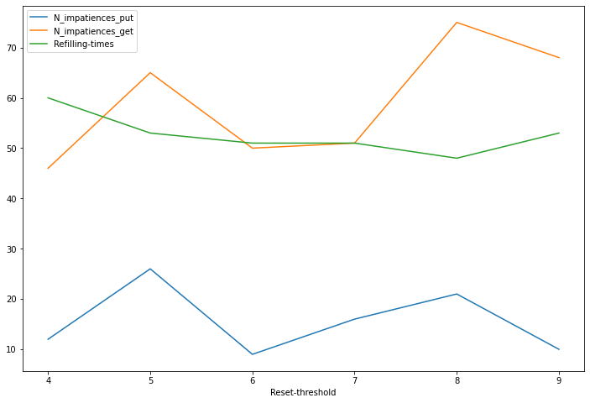
Grid search
N.stations | 20
N.vehicles | 5
Capacity | 25
Init-ratio | 0.7
Reset-ratio | 0.1
Reset-threshold | 4,5,6,7,8,9
Reset-delay | 30

Slide 25
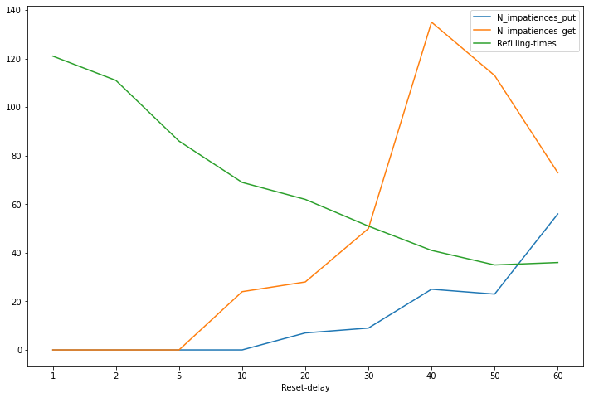
Grid search
N.stations | 20
N.vehicles | 5
Capacity | 25
Init-ratio | 0.7
Reset-ratio | 0.1
Reset-threshold | 6
Reset-delay | 1,2,5,10,20,30,40,50,60

Slide 26
Thank you !

